Slide 1
Evaluarea functiei arteriale
si interactiunea
ventriculo-arteriala
A. Ciobanu. D. Vinereanu
UMF Carol Davila
Spitalul Universitar de Urgenta Bucuresti
Notes:
1

Slide 2
Plan
1. CINE este personajul principal?!... - Endoteliul -
2. CUM evaluam functia arteriala si interactiunea artere-VS?
Si DE CE? Impact clinic?

Slide 3
Plan
1. CINE este personajul principal?!... - Endoteliul -
2. CUM evaluam functia arteriala si interactiunea artere-VS?
Si DE CE? Impact clinic?

Slide 4
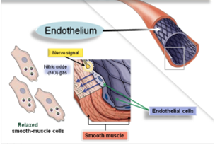
What is endothelium?
Monolayer of endothelial cells lining the lumen of the vascular beds
Mechanical role: separates the vascular wall from the circulation and the blood components
Metabolically active

Slide 5
Normal functions of the endothelium
Vascular homeostasis
Regulates vascular tone by balancing production of vasodilators (incl. NO) and vasoconstrictors
Controls blood fluidity and coagulation: production of factors that regulate platelet activity, the clotting cascade, and the ﬁbrinolytic system
Regulates the inflammatory process: production of cytokines and adhesion molecules
Normal conditions
Normal vascular tone
NO
NO
Normal coagulation
Little/ no proinflam. factors
Notes:
Under homeostatic conditions, the endothelium maintains normal vascular tone and blood ﬂuidity, and there is little to no expression of pro-inﬂammatory factors.

Slide 6
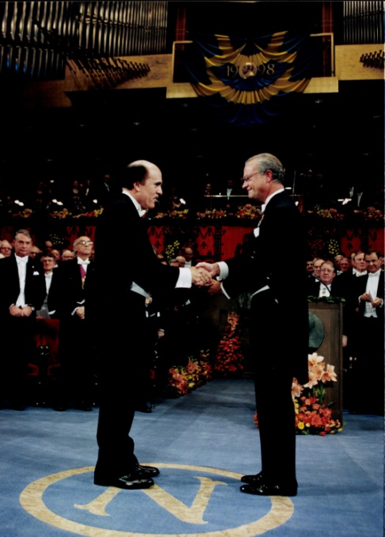
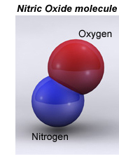
NO – “the body’s miracle molecule”
Dr. Louis Ignarro. Pharmacologist
Over 40 ys as a research scientist
Relatively simple molecule?! 2 atoms...
NOS
2015, Honoris Causa
UMF Carol Davila,
Bucharest
+
L-citrulline
1998, Nobel Prize
Karolinska Institute,
Stockholm
L-arginine + O2
Notes:
Dr. Ignarro is a pharmacologist who has spent over 40 years as a research scientist. In 1998, he was awarded the Nobel Prize in medicine for his research into NO. NO appears to be a very simple molecule since it is made up of one atom of oxygen and one atom of nitrogen.
NO este sitetizat din arginina, sub actiunea NO sintazei

Slide 7
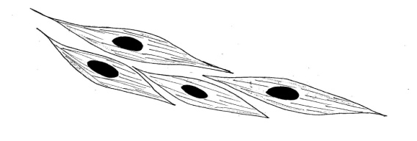
Effects of NO
Acetylcholine
Bradykinin
Shear stress
t ͦ change
Ischemia
Inflammation
Endothelium
NO
cGMP
Smooth muscle
Smooth muscle relaxation
(vasodilation!)
Antiprolif.
Regulating clotting cascade
Anti-inflamm.
Anti-oxidative
Notes:
NO este eliberat din endoteliu si difuzeaza in interiorul peretelui vasului, determinand relaxarea muschiului neted vascular ca raspuns la stimuli diversi, cum ar fi bradikinina, acetilcolina, stresul mecanic, schimbarile de temperatura, ischemia.
VD este cel mai important efect al NO, pe langa efectele sale antiproliferative, de reglare a coagularii sau efectele antiinflam si antioxidante

Slide 8
What is endothelial dysfunction (ED)?
Syndrome with systemic manifestations
Associated with significant morbidity and mortality
↓bioavailability of NO
Smooth muscle relaxation
(vasodilation!)
Antiprolif.
Regulating clotting cascade
Anti-inflamm.
Anti-oxidative
↓ Vasodilation
Proliferative
Procoagulant
Proinflammatory

Slide 9
Plan
1. CINE este personajul principal?!... - Endoteliul -
2. CUM evaluam functia arteriala si interactiunea artere-VS?
Si DE CE? Impact clinic?

Slide 10
How to assess arterial function ?
Markers of
subclinical atherosclerosis
Carotid intima-media thickness
Markers of
arterial dysfunction
Endothelial dysfunction
Arterial stiffness
Ankle-brachial index
Notes:
4 tipuri de investigatii putem sa facem si sunt recomandate: 2 masuratori simple pentru evalaurea aterosclerozei subclinice (IMT si ABI) si 2 tipuri de determinari mai complexe, cu scopul evaluarii disfunctiei arteriale, exprimate prin disfunctie a endoteliului vascular si rigiditate arteriala.

Slide 11
How to assess arterial function ?
Markers of
subclinical atherosclerosis
Carotid intima-media thickness
Markers of
arterial dysfunction
Endothelial dysfunction
Arterial stiffness
Ankle-brachial index
Notes:
Ceposibilitatipractice avem de evaluare a functieivasculare?
4 tipuri de investigatiiputemsafacem: 2 masuratori simple pentruevaluareaaterosclerozeisubclinice (IMT si ABI) si2 tipuri de determinarimaicomplexe, cu scopulevaluariidisfunctieiarteriale, exprimateprindisfunctie a endoteliului vascular sirigiditatearteriala.

Slide 12
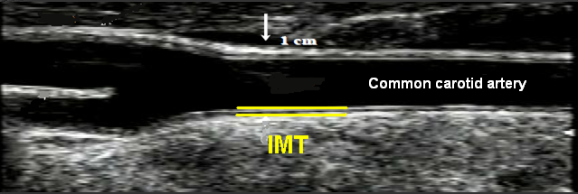
“Intima-media thickness”, IMT
Common carotid artery
High risk > 0.9 mm (Mancia, J Hypertens 2007)
> 1.06 mm(elderly, Cardiovascular Health Study, O’Leary, NEJM 1999)
> 1.16 mm(middle-aged ELSA study, Zanchetti, Circulation 2002)
Notes:
Although a carotid IMT .0.9 mm has been taken as a conservative estimate of existing abnormalities in the 2007 Guidelines, the threshold value for high CV risk was higher in the elderly patients of the Cardiovascular Health Study and in the middle-aged patients of the European Lacidipine Study on Atherosclerosis (ELSA) study (1.06 and 1.16 mm, respectively).
O’Leary DH, Polak JF, Kronmal RA, Manolio TA, Burke GL, Wolfson SK Jr. Carotid-artery intima and media thickness as a risk factor for myocardial infarction and stroke in older adults. Cardiovascular Health Study Collaborative Research Group.NEnglJMed1999;340:14 – 22.
Zanchetti A, Bond MG, Hennig M, Neiss A, Mancia G, DalPalu C, Hansson L, Magnani B, Rahn KH, Reid JL, Rodicio J, Safar M, Eckes L, Rizzini P. Calcium antag- onistlacidipine slows down progression of asymptomatic carotid atherosclerosis: principal results of the European Lacidipine Study on Atherosclerosis (ELSA), a ran- domized,double-blind,long-termtrial.Circulation2002;106:2422 – 2427.

Slide 13
IMT is associated with future cardiovascular events
2013 review and meta-analysis from 15 studies
B-mode ultrasound - common carotid artery
0.1 mm increase in IMT was predictive for:
myocardial infarction
stroke
van den Oord et al. Atherosclerosis 2013
Notes:
Au existatmultestudii care au urmaritsemnificatiaprognostica a IMT. Ne vomoprinumai la ometaanaliza din 2013 care a cuprins 15 trialurimariajuns la concluzia ca ocrestere de doar 0.1 mm a IMT este factor de prognostic pentru IM si AVC.
CIMT as measured by B-mode ultrasound is associated with future myocardial infarction and stroke.

Slide 14
How to assess arterial function ?
Markers of
subclinical atherosclerosis
Carotid intima-media thickness
Markers of
arterial dysfunction
Endothelial dysfunction
Arterial stiffness
Ankle-brachial index
Notes:
Farasarenuntam la a privipacientul ca un intreg in practica de zi cu zi, ne vomrestrange in urmatoarele 20 de minute la perspectivaafectariivasculare la pacientanoastrahipertensiva.
Ceposibilitatipractice avem de evaluare a functieivasculare la aceastapacienta?
4 tipuri de investigatiiputemsiesterecomandatsafacem pt ea: 2 masuratori simple pentruevalaureaaterosclerozeisubclinice (IMT si ABI) si2 tipuri de determinarimaicomplexe, cu scopulevaluariidisfunctieiarteriale, exprimateprindisfunctie a endoteliului vascular sirigiditatearteriala.

Slide 15
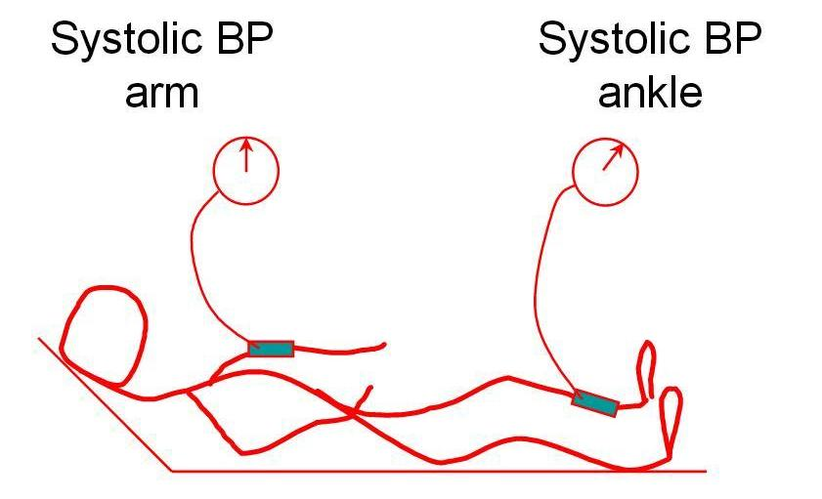
“Ankle-brachial index”, ABI
Systolic BP ankle (posterior tibial a. or dorsalis pedis a.)
ABI =
Systolic BP arm (brachial a.)
< 0.9 : subclinical atherosclerosis
< 0.5: severe peripheral artery disease (PAD)
> 1.3: incompressible vessels
AHA Statement. Circulation 2000
Notes:
The ABI is a simple, noninvasive measure associated with atherosclerotic cardiovascular disease and death
ABI este un parametrusimplu de calculatsinoninvaziv. O valoaremai mica de 0.9 indica ATS subclinica, in timpce un indice de sub 0,5 este un semn de boalaarterialaperifericasevera. Arterelefoarte sever afectate, intenscalcificate, se inostesc de obicei de un indicemai mare de 1,3 fiindaproapenecompresibile.

Slide 16
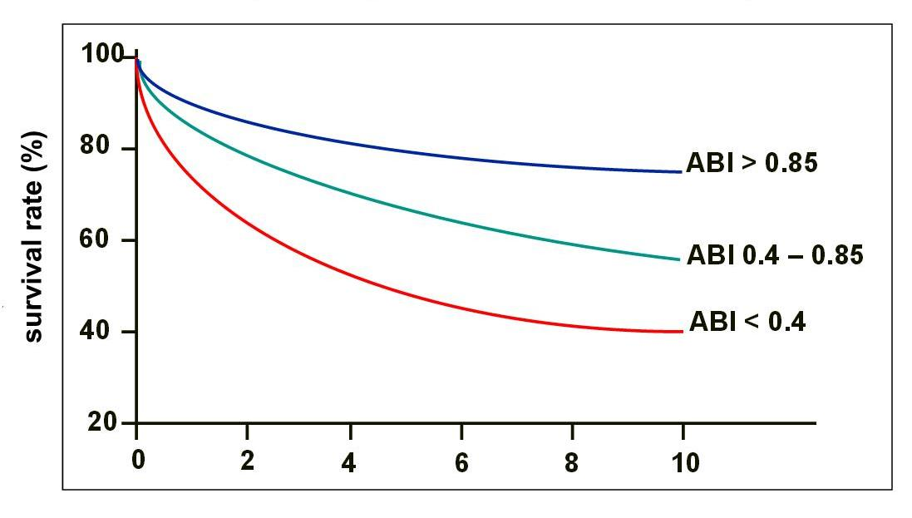
ABI = independent predictor of mortality
PAD: 10-year survival stratified by ABI
744 pts.
McKenna et al. Atherosclerosis 1991
Notes:
ABI a fostdovedit ca fiind predictor de mortalitateinca din anii 90. Un studiu care a cuprinspeste 700 de pacienti a aratat ca aceastamasuratoaresimpla, daca are valoarescazuta (in principiu sub 0.8) este un indicator de prognostic nefavorabilsiobliga la investigareasi a altorteritoriivascularedpdv al incarcariiateromatoasesitratamentadecvat.
744 pts; ABI < 0.85; Our results suggest that the relatively technically simple measure of the ratio of ankle to brachial blood pressures, if low, carries a very poor prognosis and should prompt investigation and treatment of atherosclerotic disease in other vascular systems.

Slide 17
PAD and critical limb ischemia = more deadly than cancer
http://seer.cancer.gov 2013
Notes:
Decese care, asa cum se vede din acestraportaparutanultrecut, sunt in numarmai mare decat la pacientiidiagn cu cancer de san. Astfelincat se observa ca pacientii cu ischemiecriticaperiferica au mortatlitate de aproape 70% la 5 ani, comparativ cu un risc de 11% pentrucancerul de san.
the 5-year all-cause mortality rate for PAD is about 30%, and for breast cancer, it is much lower, only around 12%. The only cancer that has a higher 5-year all-cause mortality rate is colorectal cancer, and that is about 36%. Now, if you have CLI, the 5-year mortality rate is around 70%.

Slide 18
How to assess arterial function ?
Markers of
subclinical atherosclerosis
Carotid intima-media thickness
Markers of
arterial dysfunction
Endothelial dysfunction
Arterial stiffness
Ankle-brachial index
Notes:
Farasarenuntam la a privipacientul ca un intreg in practica de zi cu zi, ne vomrestrange in urmatoarele 20 de minute la perspectivaafectariivasculare la pacientanoastrahipertensiva.
Ceposibilitatipractice avem de evaluare a functieivasculare la aceastapacienta?
4 tipuri de investigatiiputemsiesterecomandatsafacem pt ea: 2 masuratori simple pentruevalaureaaterosclerozeisubclinice (IMT si ABI) si2 tipuri de determinarimaicomplexe, cu scopulevaluariidisfunctieiarteriale, exprimateprindisfunctie a endoteliului vascular sirigiditatearteriala.

Slide 19
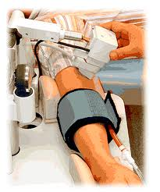
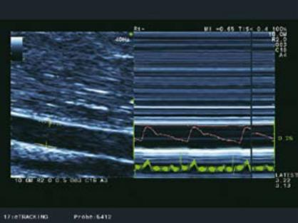
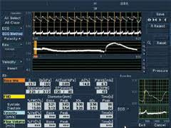
Flow mediated dilation (FMD)
Right brachial artery
The change (%) in brachial artery diameter after 5’ of cuff inflation induced ischemia
Normal FMD > 10%
Quiet room, controlled temperature
No smoking/coffee/eating for the last 12 h
Notes:
Inpractica, fcendot se evalprindetdilatatiei mediate de flux la nivelulartereibrahialedrepte, masurandvariatiaprocentuala a diametrului arterial dupa 5 minute de ischemieindusa de umflareamanseteitensiometrului la nivelulantebratului.

Slide 20
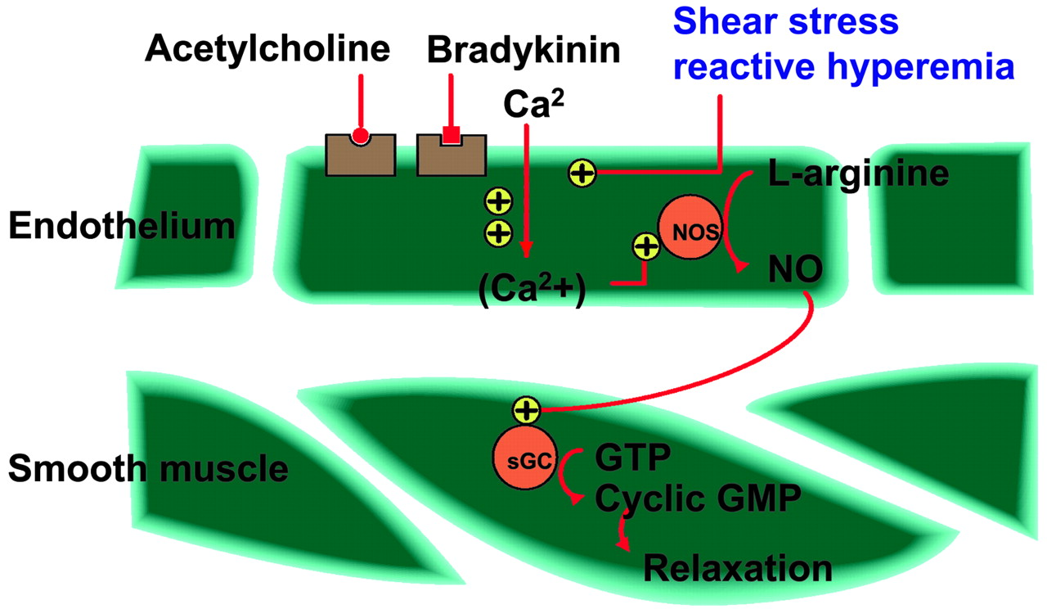
Mechanism for endothelial function assessment
Lerman A, et al. Zeiher Circulation. 2005
Notes:
Diagram illustrating mechanism that clinical studies of assessing endothelial function are based on.
Assessment of endothelial function is based on principle of conversion of amino acid l-arginine to NO by enzyme NO synthase. This process may be receptor-dependent (such as in response to acetylcholine) or via a non–receptor-dependent mechanism (such as shear stress induced by reactive hyperemia). NO diffuses to smooth muscle cells and mediates relaxation through cGMP mechanism.

Slide 21
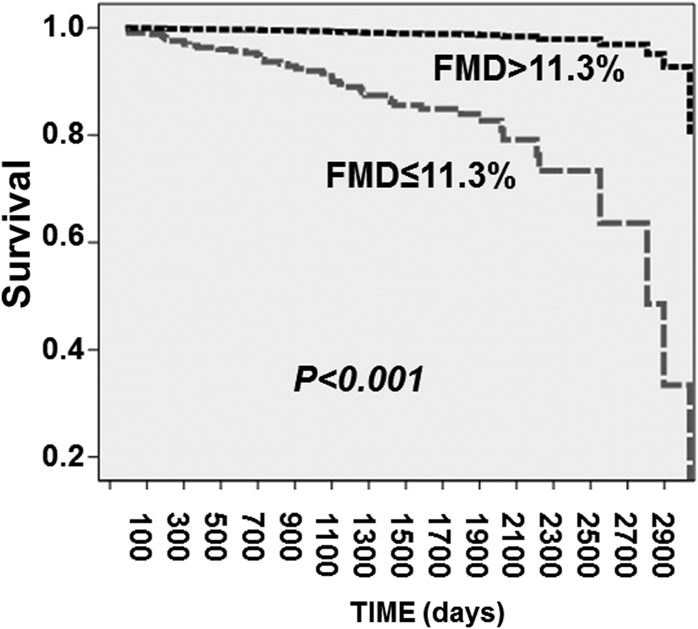
FMD independently predicts long-term adverse CV events in subjects without heart disease
Until the first composite adverse CV end point:
Cardiac mortality
Nonfatal MI
Hospitalization for HF/AP
Stroke
CABG
PCI
618 subjects
Shechter et al. Am J Cardiol 2014
Notes:
Si pentru DE avem date foartenoi, acumpublicate, dintr un studiupemaimult de 600 de subiecti, care demonstreazaincao data ca pacientiifaraboalacardiacacunoscuta, dar care au disfunctieendoteliala, cuantificataprinscaderea FMD sub 11%, au un prognostic mai prost petermen lung, manifestatprindeces, IM nonfatal, spitalizare pt IC/AP, AVC, CABG sau PCI.
618 subiecti
A Kaplan-Meier survival curve showing survival until the first composite adverse CV end point (cardiac mortality, nonfatal myocardial infarction, hospitalization for heart failure or angina pectoris, stroke, coronary artery bypass grafting, and percutaneous coronary interventions) in subjects with FMD above (dashed line) and below (solid line) the median value of 11.3%, after controlling for traditional risk factors (age, gender, lipoproteins, diabetes, hypertension, and BMI). Patients with FMD below the median had lower survival rate compared with those with FMD above the median (p<0.001)

Slide 22
How to assess arterial function ?
Markers of
subclinical atherosclerosis
Carotid intima-media thickness
Markers of
arterial dysfunction
Endothelial dysfunction
Arterial stiffness
Ankle-brachial index
Notes:
Farasarenuntam la a privipacientul ca un intreg in practica de zi cu zi, ne vomrestrange in urmatoarele 20 de minute la perspectivaafectariivasculare la pacientanoastrahipertensiva.
Ceposibilitatipractice avem de evaluare a functieivasculare la aceastapacienta?
4 tipuri de investigatiiputemsiesterecomandatsafacem pt ea: 2 masuratori simple pentruevalaureaaterosclerozeisubclinice (IMT si ABI) si2 tipuri de determinarimaicomplexe, cu scopulevaluariidisfunctieiarteriale, exprimateprindisfunctie a endoteliului vascular sirigiditatearteriala.

Slide 23
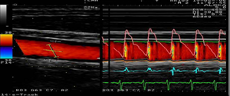
Arterial stiffness and
ventricular-arterial interaction
Wave intensity
(right common carotid artery)
Multiple parameters:
beta index
Young elastic module
augmentation index
first systolic peak
second systolic peak
negative area
Notes:
Functiaarterialaam evaluatoprindetparametrilor de rigiditatearteriala la nivelul ACC drepte, cum arfiindexul beta, modulul elastic al lui Y sauindicele de augmentare, precumsideterminareavitezeiundeipulsuluiprinmetodaComplior. Aceasta se bazeazapecalcularea automata de catreaparat a vitezeiundei de pulsintre 2 nivele, carotidiansifemural, cunoscanddistantadintreacestea, masurata de noi cu un cm.
Desi initial ghidurile din 2007 au considerat PWV de 12 m/s ca fiindlimita de la care se poatevorbi de rigiditatearteriala, un expert consensus din 2012 a recalculataceastavaloare, tinand cont ca distantareala, anatomica, carotidofemuralape care otraverseazaunde de pulseste cu 20% mai mica decatceaestimata.

Slide 24
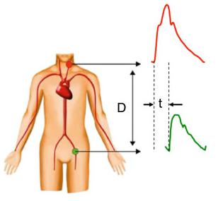
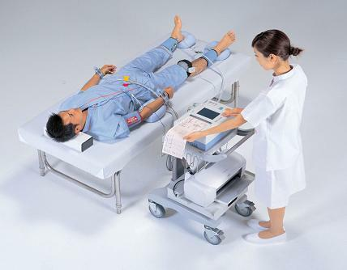
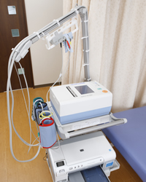
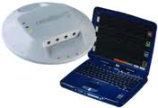
Arterial stiffness
Pulse wave velocity (cf PWV)
Carotid-ankle vascular index (CAVI)
(carotid-femoral)
Complior
Direct straight distance between 2 sites (carotid and femoral)
PWV = Distance / time
12 (2007) → 10 m/s(2012) as a cut-off for CV event’s prediction
Index of overall stiffness of the artery from the origin of the aorta to the ankle
Independent of BP
Awaits for validation
Notes:
Functiaarterialaam evaluatoprindetparametrilor de rigiditatearteriala la nivelul ACC drepte, cum arfiindexul beta, modulul elastic al lui Y sauindicele de augmentare, precumsideterminareavitezeiundeipulsuluiprinmetodaComplior. Aceasta se bazeazapecalcularea automata de catreaparat a vitezeiundei de pulsintre 2 nivele, carotidiansifemural, cunoscanddistantadintreacestea, masurata de noi cu un cm.
Desi initial ghidurile din 2007 au considerat PWV de 12 m/s ca fiindlimita de la care se poatevorbi de rigiditatearteriala, un expert consensus din 2012 a recalculataceastavaloare, tinand cont ca distantareala, anatomica, carotidofemuralape care otraverseazaunde de pulseste cu 20% mai mica decatceaestimata.

Slide 25
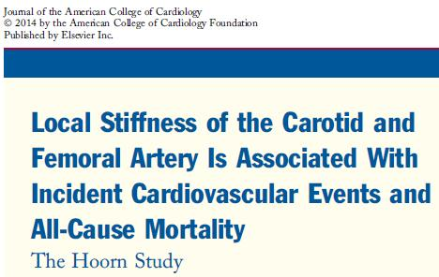
Arterial stiffness is associated with CV events AND all-cause mortality
648 pts.
Data from 2000 Hoorn study (a population-based cohort study on glucose metabolism and CVD risk among the inhabitants of Hoorn, Netherlands)
Different stiffness parameters assessed; association with CV events and CV deaths.
van Sloten et al. JACC 2014
Notes:
Cedoveziavem de data aceastapentruvaloareaprognostica a parametrilor de rigiditatearteriala? F multe, dintre care osa ma oprescastazidoar la celemairecente, publicate in JACC anulacesta. Suntrezultatedintr un studiumai mare, care a urmaritsubiectidintr un orasel din Olanda, Hoorn, …………..
Au fostevaluatiparametrii de rigiditatearteriala la nivelcarotidofemuralsis a demasociereaacestoraatat cu ev CV, cat si cu mortalitatea de cauza CV.
Carotid and femoral stiffness indices are independently associated with incident cardiovascular events and all-cause mortality. The strength of these associations with events may differ per stiffness parameter.

Slide 26
Pulse wave – normal
Pulse wave – aging & risk factors
v >>
v >>
Dya
Sys
t <<
Blumenfeld 1994
Notes:
In timpulcoclului cardiac, undele de pulssunt generate ritmicsi se propagapanainntreflectateinapoicatre aorta. Reflectareaundelor in periferie are loc la nivelulramificatilor, acoloundeeschimbaimpedanta, siestecuantificata de Aix.
In arterelerigide, viteza de circulatie a undeipulsuluiestemai mare. Astfel ca undadepulsajungemairepede in periferie, estereflectatamairepedecatreinima, la care ajungeinainte a aceastasaterminesistola, inainte de inchidereavalveloraortice, crescandpostsarcina.

Slide 27
Pulse wave – normal
Pulse wave – aging & risk factors
PWV
≈ 15 m/s
More proximal
site reflection
PWV
≈ 5 m/s
Reflected wave
in systole
Reflected wave
in diastole
↑ ↑Central
syst pressure
↓ Central
diast pressure
↑ Central
diast pressure
↑ LV
afterload
↓ Coronary
perfusion pressure
Coronary
perfusion pressure
Subendocardial ischaemia
LV hypertrophy
LV (subendocardial) dysfunction

Slide 28
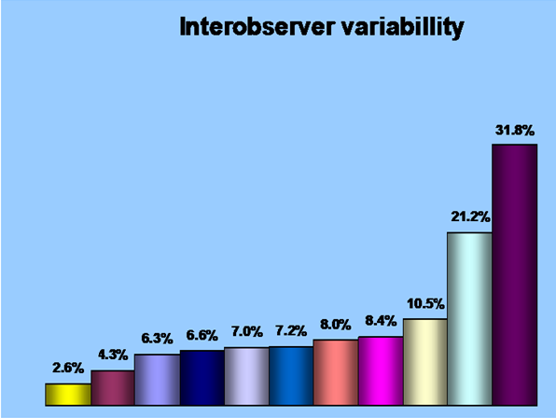
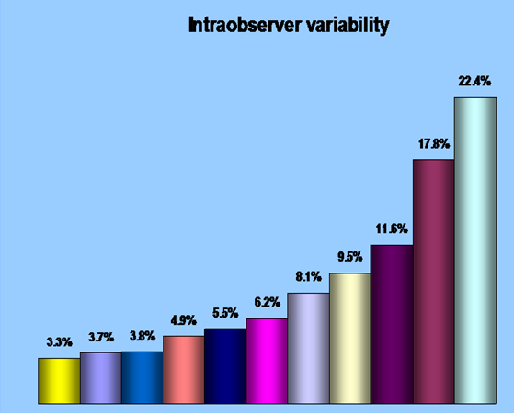
Reproducibility
Magda SL, Ciobanu AO, Florescu M, Vinereanu D. Heart Vessels 2013.
Notes:
Parametrii de functievascularadespre care am vbpanaacumsi care au avutcorelatiisemnificative in trialurileclinice au obunareproductibilitate, asa cum aratasidatelepublicate de noianultrecut. de variabilitateatat inter cat siintraobservator. Dintretoti, PWV a fostparametrul cu ceamaibunareproductibilitate.

Slide 29
Progression from risk factors
- vascular disease- cardiac involvement - HF
Risk Factors
Endothelial
Dysfunction
Arterial stiffness
Neurohormonal
activation
Fibrosis
Ischaemia
Subendocardial
Dysfunction
LVH
Heart failure
Fraser & Vinereanu.
In: “Doppler Myocardial Imaging. A Textbook.” 2006

